Slide 1

The Learning Journey
A case study-oriented presentation by Yordan Yordanov (assistant professor and PhD candidate)

Slide 2
The problem

Slide 3
The reason
Lack of focus
Technological Distractions
Persistent desire for online games
Educational Environment and Teaching Methods
Psychological Factors

Slide 4

Suggestopedia is a teaching methodology that is based on the belief that creating a positive and comfortable learning environment can reduce the psychological barriers that hinder learning. This, in turn, enhances the ability to acquire new knowledge.
The methodology
Developed and validated by Bulgarian psychotherapist Dr. Georgi Lozanov, nominated for a Nobel prize

Slide 5
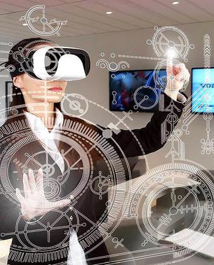



Ultimate Solution
Creating an immersive digital environment, incorporating multimedia elements, employing adaptive learning algorithms, facilitating social interaction, monitoring emotional and psychological states, conducting continuous research and development, and addressing ethical and privacy considerations. By blending technological innovation with pedagogical principles, learning solution can revolutionize educational content delivery, making learning more engaging, personalized, and effective.

Slide 6
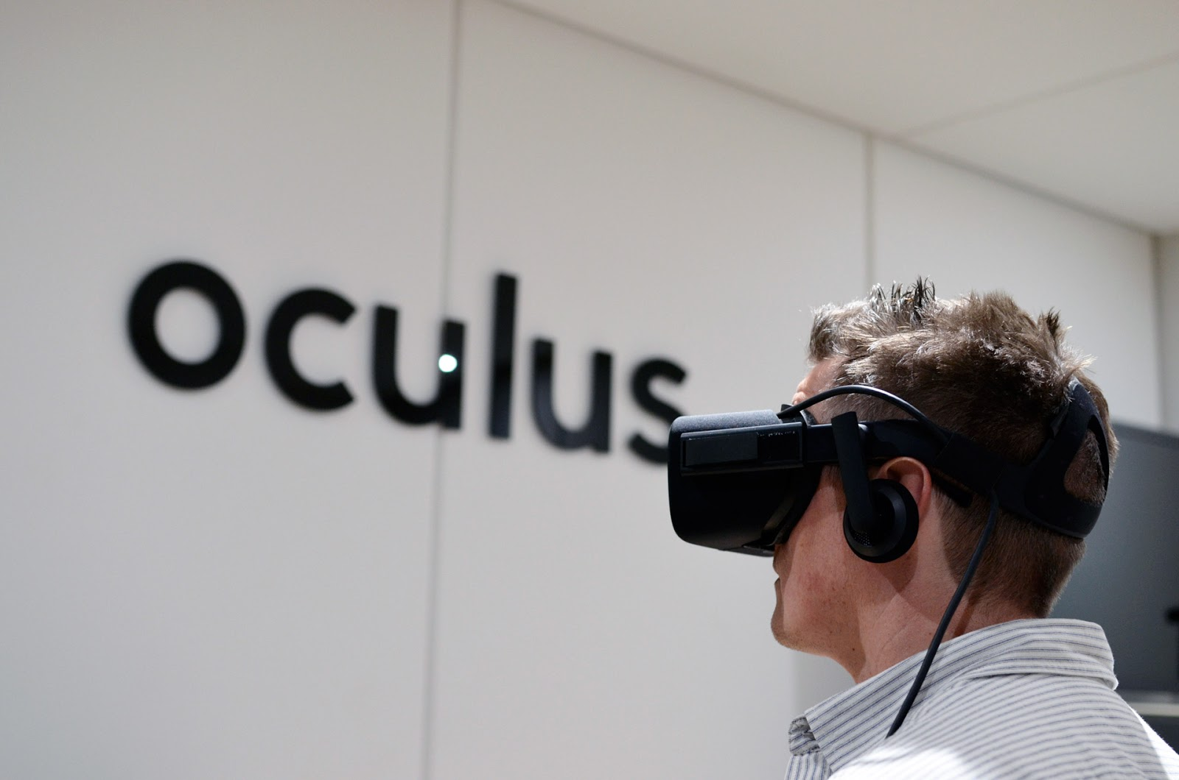



The Competitors
Oculus
DreamBox
Platforms such as Coursera, Udemy, and Khan Academy
Learning Management Systems (LMS) with Advanced Features
part of Meta
part of Pearson
And many more..

Slide 7

DreamBox
Learning Management Systems (LMS) with Advanced Features
Oculus
A hub for all kind of learning technologies

Slide 8

Innovation
The project has a naturally ambitious scope, as it is intended to be developed, utilized, and tested by students from our university. Due to its educational nature, there is the option to extend the timeline as needed, guaranteeing comprehensive development and integration. This approach also facilitates the ongoing assimilation and incorporation of cutting-edge technologies and tools, thereby augmenting the project's pertinence and efficacy as time progresses.

Slide 9

Working Prototype
https://students-manager.website/

Slide 10


Thank You
jordanov.jordan@ue-varna.bg

